Slide 1





Grimm’s Academy
1st Life
Covert PCAPS

Slide 2
PCAP – 1 – Needle in a Haystack
We captured a ton of traffic, can you sift through it to find anything interesting?
Some people might think they are secure because they are hidden in the masses, the needle in the haystack.
needleinahaystack.pcapng

Slide 3
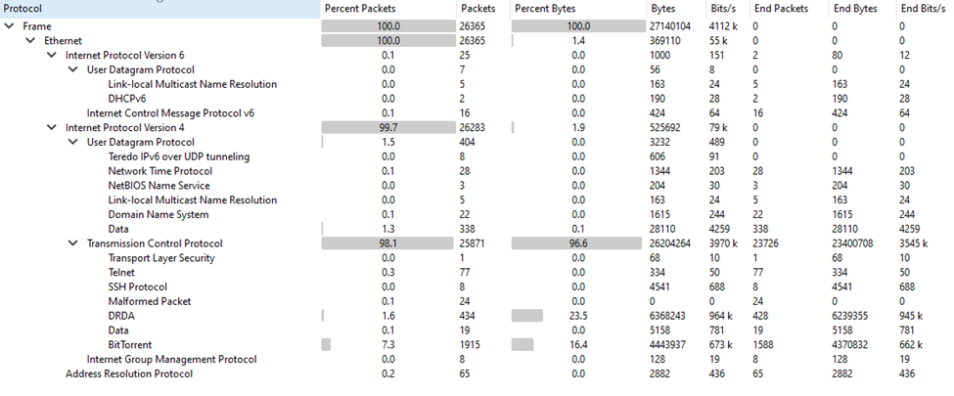
What is in the PCAP
Start off with looking at the protocol hierarchy

Slide 4
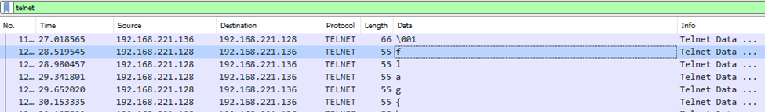
Unencrypted Channels
What are the common unencrypted channels?
Telnet is easy to view because there is no encryption
We examine the Data field under Telnet to see what is being sent
We see all the characters being typed across the wire

Slide 5
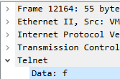
Tshark Solution
-join (.\tshark.exe -r 'needleinahaystack.pcapng' -Y "telnet" -T fields -e telnet.data | ?{$_ -cne " "})
join at the beginning will combine all the items into a single line which will make it easier to read (after the follow is ran)
Tshark –r will read in the pcap
-Y is the filter of telnet
-T fields is to format the output as text based of fields of the packet
-e is the field name to extract; here it is the telnet.data
All piped to remove any blank lines

Slide 6
Easy Right?
That one was pretty easy to spot
A good warm-up
Made sure that we have a working Wireshark
Next one will not be so easy…

Slide 7
PCAP – 2 - Suspicious
We found some suspicious traffic on our network and think there could be some malware using covert channels to convey messages.
We isolated the suspicious traffic for you to take a look.
suspicious.pcapng

Slide 8
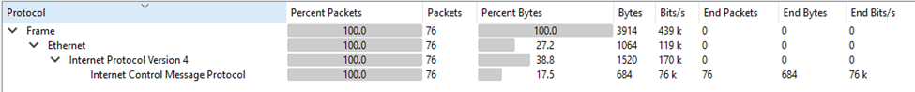
Protocol Hierarchy
Lets start off by looking at what is in the pcap:

Slide 9
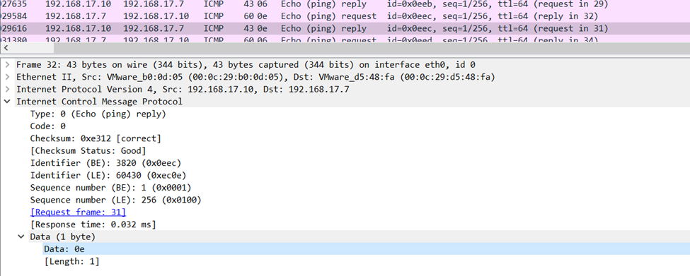
ICMP
We see that there are just a bunch of pings going back and forth.
What item is hidden in the ping?

Slide 10
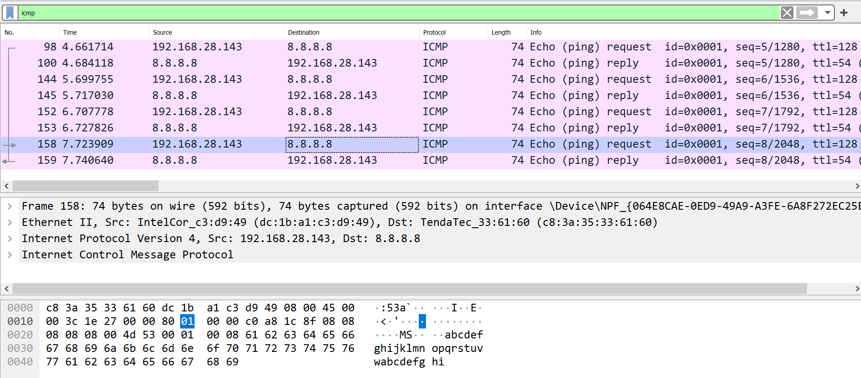
What is normal Ping?
Notice the alphabet in a normal Ping request?
Also do you see that this does not by default have a data section?

Slide 11
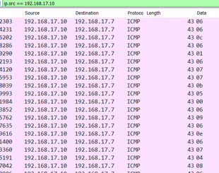
What is in the data field?

Slide 12
Encoded Flag
If we put all these together we get a bunch of items that looks like some sort of encoding… but how can we decide which one?
Lets look at the data we collected:
0606060c06010607070b05000609060e06070408060107030404060107040601030f070d000a
Numbers 0-9 and letters a-f
Maybe there is a leading 0 on everything?
666c61677b50696e67486173446174613f7d0a
This leads us to Hex
66 6c 61 67 7b 50 69 6e 67 48 61 73 44 61 74 61 3f 7d 0a

Slide 13
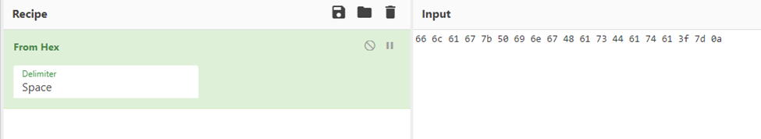
Decoding the Hex
The Easy method to decode the hex is to drop it into CyberChef

Slide 14
New Bonus Challenge
Can you solve this in a creative way through the command line?
If you have a creative way to solve it I would like to see!

Slide 15
Challenge Accepted
Powershell one-liner!
-join ([string]::join("",(.\tshark.exe -r 'suspicious.pcapng' -Y "ip.src==192.168.17.7" -Tfields -e data | %{$_[1]})) -split '(..)'|? {$_}|%{[char][convert]::touint32($_,16)})

Slide 16
What is going on in this?
tshark is reading in the pcap with a search filter of one of the two IP addresses.
It is then extracting out the single ping data field from the results
Then it is dropping the leading 0 from the results so that we can combine them to get the true hex result
joining the the data together into a single line
splitting all the data from one long list of characters to 2 char hex
converting the hex to ASCII

Slide 17
A little bit tougher?
Using a Ping data field to hide data is sneaky.
Encoding the data in hex means that there is a good chance we may not spot it.
This just shows that data can hide in protocols that normally do no carry information

Slide 18
PCAP – 3 - Transfer
We heard that someone was transferring something important over the net.
We think it might be the flag to this challenge, can you find it?
transer.pcap

Slide 19
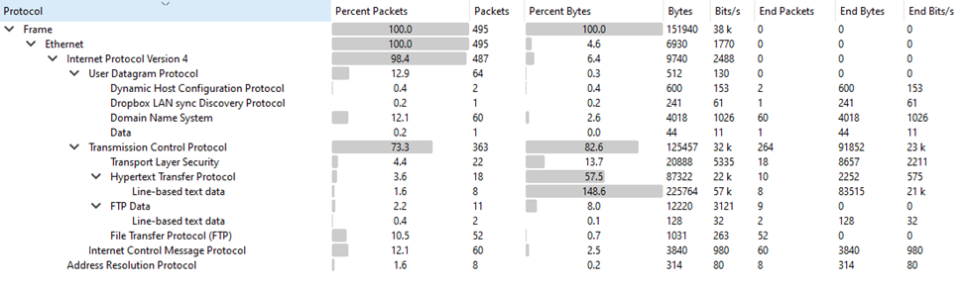
Protocol Hierarchy

Slide 20
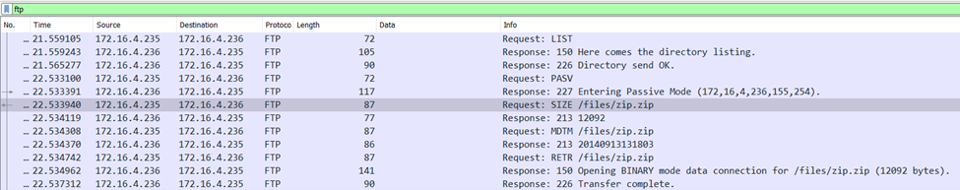
FTP
For this pcap we see FTP in plain text, so we can start off looking at that protocol first.
We can see in this protocol that there was a file that was Retrieved with the RETR command

Slide 21
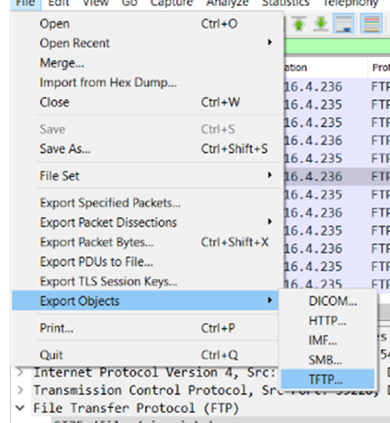
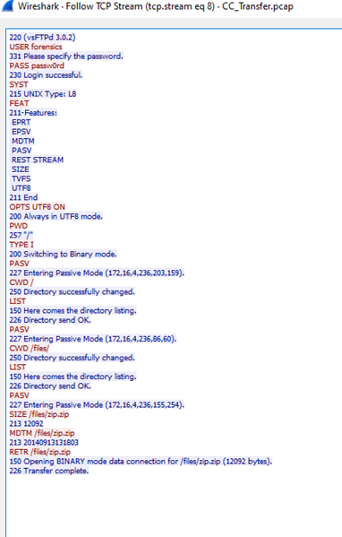
Exporting Objects from Wireshark
We can attempt to export tftp objects
The only thing we can see here though is that the file zip.zip with a size of 12092 bytes was downloaded

Slide 22
FTP-Data
One other protocol that was can look into is the FTP-Data
FTP-Data is where the data that is transferred usually takes place in Wireshark
We can Follow the stream and save as…
Import item of note is the magic byte header is a PK which is to indicate that it is a zip or compressed file of some sort.

Slide 23
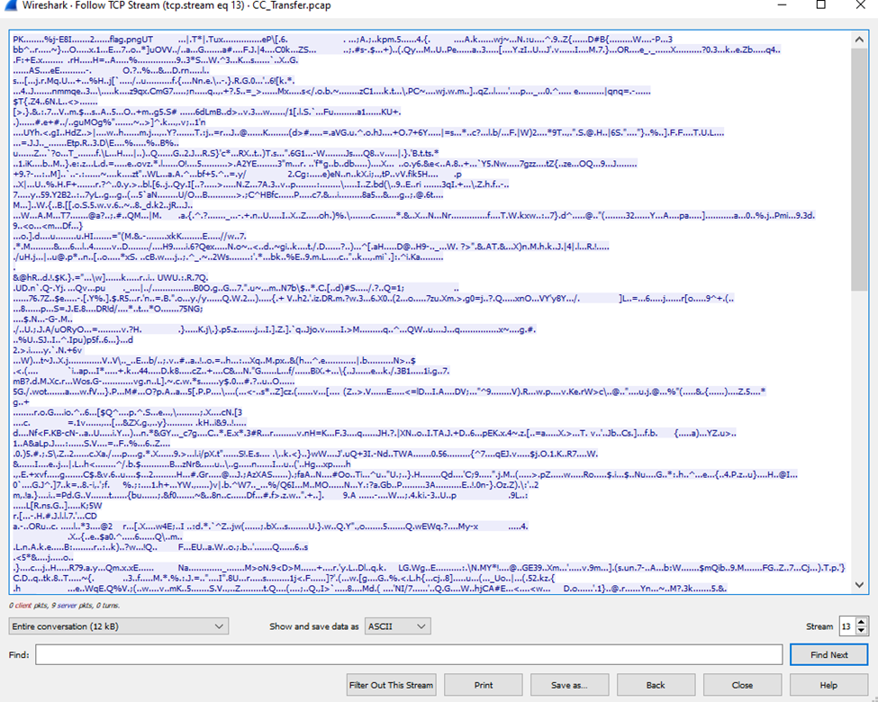
Extraction

Slide 24
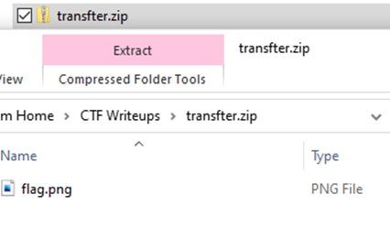
Zip.zip
Once we have the file extracted we see inside the zip file that there is a flag.png

Slide 25
We knew that already!
Just a little refresher on FTP – data carving.
You can not just extract the data from the file exports.
Ready for the toughest one yet?
Have you found this one already?
It’s only 42 packets long how hard could it be?

Slide 26
PCAP – 4 - Suspiciouser
We found some suspicious traffic on our network and think there could be some malware using covert channels to convey messages.
We isolated the suspicious traffic for you to take a look.
Suspiciouser.pcapng

Slide 27
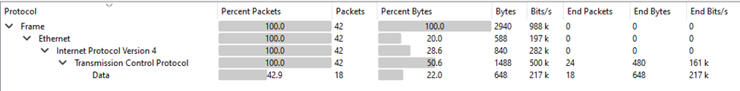
Protocol Hierarchy
We can see that this is all TCP packets with a Data Field on some of the packets.

Slide 28
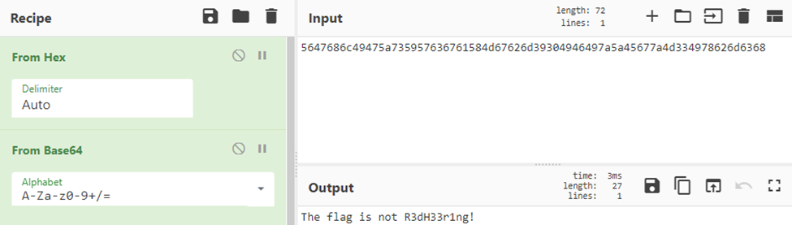
Data Trickery!
To start off let us dig into that data field and see what is going on here. We see the following characters in all the data fields: 5647686c49475a735957636761584d67626d39304946497a5a45677a4d334978626d6368
Let’s take this info to cyber chef and try to decode it. It looks like it was all in hex so here is the results of converting from Hex and then from base64

Slide 29
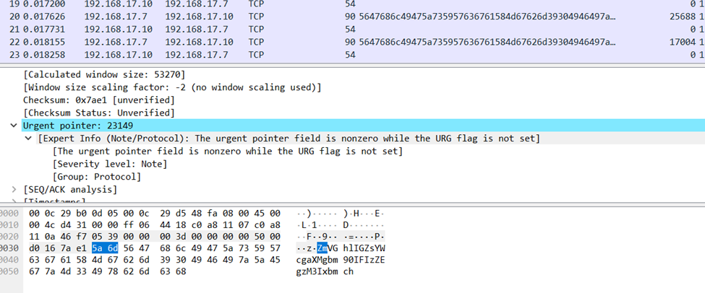
Pointers?
So, we know that this is not the answer, we need to look into the packets a little bit more to see what else we can find that is not right. In the packet information we see that the Urgent Pointer filed is highlighted:

Slide 30
Pulling it together
We can now see that with adding a column with the urgent pointer we see that all of the pointers are different. In the first packet we see that the hex is 5a 6d or Zm
The second packet is 78 68 or xh, Third Packet is 5a 33 or Z3 and the 4th packet is 74 55 or tU.
We have ZmxhZ3tU
This looks like a base64 pattern so let’s look at cyberchef and see if that decodes to anything that might resemble a flag.
We can manually do this, or is there a way to script it?

Slide 31
Scripting it out!
[system.text.encoding]::ascii.getstring([system.convert]::frombase64string(-join ((.\tshark.exe -x -r 'Suspiciouser.pcapng' -Y "ip.src==192.168.17.7" |Select-String 0030 |%{($_ -split " ")[6..7]}) -split '(..)'|%{$_ -replace "00",""}|?{$_}|%{[char][convert]::touint32($_,16)})))

Slide 32
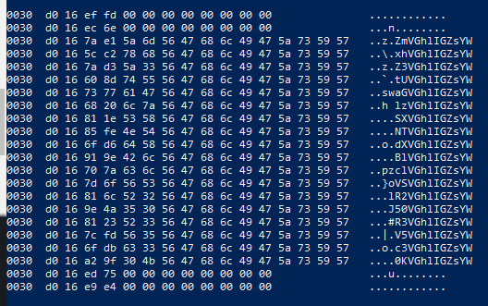
Decoding the script
tshark dumps the hex version of the query on the read in pcap with the –x
select-string 0030 pulls only the line with the urgent pointer located in it
Split on spaces to grab the fields with the hex of the data we want to pull and also drop all the empty 00 hex codes
Finally we can then take that output and convert from hex; which leaves us with a base64 encoded item that we can then decode to get the final flag.

Slide 33
Recap
There are Covert Channels that can be used to exfil data.
They take a little bit of digging to find them
Data can be encrypted in Base64, Hex or so many other forms.
Keep an eye out for the little bits if you can.

